Slide 1

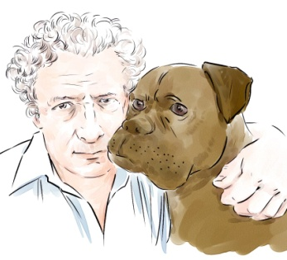
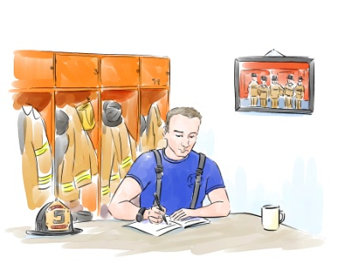

4
Unit 8 Section A
Passion guides life choices
FOREIGN LANGUAGE TEACHING AND RESEARCH PRESS
AIR FORCE ENGINEERING UNIVERSITY
Notes:
1

Slide 2

Practical Phrases | Meanings
1. put out | 展示；张贴；公告
2. alert sb. to sth. | 提醒（某人）注意
3. lay siege to sth. / sb | 向…展开攻势；围攻
4. follow suit | 跟着做；仿效
5. stand / stay / remain on the sidelines | 袖手旁观；置身事外
6. get revenge (on sb.) for sth. | 因为…报复（某人）
7. appeal to sb. to do sth. | 呼吁某人做某事

Slide 3

展示；公告
短语逆译
put out
短语应用
政府发表了一项声明，否认了这些谣言。
意群提示
(statement / rumour)
The government has put out a statement denying these rumours.

Slide 4
提醒（某人）注意
短语逆译
alert sb. to sth.
短语应用
该组织公布了一系列平面广告和广播广告，希望提醒人们注意酒后驾驶和超速的危险。
意群提示
(print and broadcast ads / drink driving / speeding)
The organization unveiled a series of print and broadcast ads, hoping to alert the young people to the dangers of drink driving and speeding.

Slide 5
向…展开攻势；围攻
短语逆译
lay siege to sth. / sb.
短语应用
阻止新法规实施的唯一办法就是向委员会的所有成员展开攻势说服其投反对票。
意群提示
(have sth. stopped / persuade sb. to / vote against )
The only way to have the new law stopped is to lay siege to all members of the committee and persuade them to vote against it.

Slide 6
仿效
短语逆译
follow suit
短语应用
禁烟令引发了关于其他省份是否也要仿效的争议。
意群提示
(the smoking ban / spark a debate )
The smoking ban has sparked a debate as to the other provinces should follow suit.

Slide 7
袖手旁观；
置身事外
stand / stay / remain on the sidelines
短语逆译
短语应用
过去两年里，消费者一直处于观望的状态，推迟了他们的购车计划。
意群提示
(defer / purchase)
For the last two years, consumers have been standing on the sidelines and deferring purchases of automobiles.

Slide 8
因为…报复（某人）
短语逆译
get revenge (on sb.) for sth.
短语应用
她发誓要报复他曾经对她做的那些坏事。
意群提示
(swear / do wrong to sb.)
She swore to get revenge for the wrongs he had done to her.

Slide 9
呼吁某人做某事
短语逆译
appeal to sb. to do sth.
短语应用
他呼吁国际社会继续努力，通过对话找到一个持久的解决方案。
意群提示
(international community / a lasting solution )
He appealed to the international community to continue to work for a lasting solution through dialogue.

Slide 10

Functional Patterns | Functions & Usages
From decades / years / months spent doing sth., sb. became good / efficient / skilled / skillful / adept at … | 用于表达“长期做某事对某人的影响”。
2. When sb. began to do sth., sb. never thought … , but … | 用于表达“事情的发展超出某人最初的预料”。
3. One essential mark of … is … | 用于表达“……的一个根本标志是……”。
Notes:
10

Slide 11
原句译文
经过几十年为弱势及受压迫群体所做的抗争，亨利变得非常善于策划各种活动。
逆译练习
From decades spent working on the side of the weak and oppressed, Henry became efficient at masterminding campaigns. （Line 1, Para. 5）
句型提炼
Notes:
11

Slide 12

句型提炼
From decades / years / months spent doing sth, sb. became good / efficient / skilled / skillful / adept at …
应用提示
用于表达“长期做某事对某人的影响”。
句型应用
Notes:
12

Slide 13
典型例句
数年的外企工作经历使她变得善于与来自不同文化背景的人合作。
意群提示
(collaborate with)
From years spent working in a foreign company, she became skillful at collaborating with people from different cultures.

Slide 14
原句译文
在我开始动笔的时候，我从来没想到亨利能看到完整的初稿，但是他一直活到亲眼看到书在纽约的书店出售。
逆译练习
When I began writing, I never thought Henry would see a completed draft, but he lived to see the book on sale in a New York bookstore. （Line 3, Para.12）
句型提炼
Notes:
14

Slide 15
句型提炼
When sb. began to do sth., sb. never thought …, but …
应用提示
用于表达“事情的发展超出某人最初的预料”。
句型应用
Notes:
15

Slide 16
典型例句
当我着手写这部小说时，我从没想到它能引起轰动，但是它竟然成为年度最畅销书之一。
意群提示
(make a hit / stir / bestseller)
When I began to write the novel, I never thought it would make a hit, but it turned out to be one of the bestsellers of the year.

Slide 17
原句译文
一个人活得好的一个根本标志就是，在他回首自己人生的时候，他对自己的成就感到满意，而且能够冷静地接受死亡、面对永恒。
逆译练习
One essential mark of living well is to be satisfied with one’s accomplishments when taking a retrospectivelook at life, and to be able to accept death and face infinity calmly. (Line 1, Para.13)
句型提炼
Notes:
17

Slide 18
句型提炼
One essential mark of … is …
应用提示
用于表达“…的一个根本标志是…”。
句型应用
Notes:
18

Slide 19
典型例句
一个人走向成熟的一个根本标志是，他能够区分理智决定和情感冲动之间的不同。
意群提示
(differentiate between / rational / emotional impulse)
One essential mark of a person growing mature is to be able to differentiate between rational decision making and emotional impulse.

Slide 20



他的衣着邋遢，头发也未曾梳理。他说话非常直率并且粗俗，有时我甚至认为，我好像是在听一个暴力团伙的杀手在讲话。
a. His clothes were untidy, and his hair uncombed. His language was so blunt and earthy that at times I thought I was listening to an assassin from a violent mob.(Para.4, L3)

Slide 21
b. How could one individual, however humane and passionate, possibly bring about change in the face of powerful global corporations, ministerial indifference and complicated parliamentary rules?(Para.6, L2)
在面对强大的跨国公司、冷漠的执政部门和众多复杂的议会规则时，单单一个人，不管他多么具有人道主义，多么富有激情，又如何能促成改变呢？

Slide 22

一个人活得好的一个根本标志就是，在他回首自己人生的时候，他对自己的成就感到满意，而且能够冷静地接受死亡、面对永恒。
c. One essential mark of living well is to be satisfied with one’s accomplishments when taking a retrospective look at life, and to be able to accept death and face infinity calmly. (Para.13, L1)

